Slide 1
NETWORK LAYER:
LOGICAL ADDRESSING

Slide 2
IPv4 ADDRESSES
An IPv4 address is a 32-bit address that uniquely and universally defines the connection of a device (for example, a computer or a router) to the Internet.

Slide 3
An IPv4 address is 32 bits long.
The IPv4 addresses are unique
and universal (all nodes connecting Internet must have IP addresses).
The address space of IPv4 is
2³² or 4,294,967,296.

Slide 4

Figure 1 Dotted-decimal notation and binary notation for an IPv4 address

Slide 5
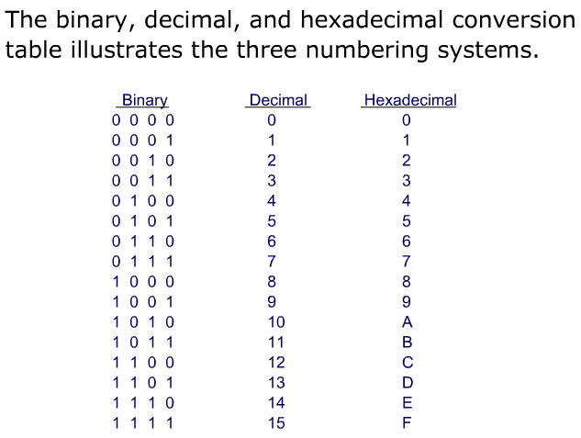

Slide 6


Example 1
Change the following IPv4 addresses from binary notation to dotted-decimal notation.
Solution
We replace each group of 8 bits with its equivalent decimal number and add dots for separation.

Slide 7


Example 2
Change the following IPv4 addresses from dotted-decimal notation to binary notation.
Solution
We replace each decimal number with its binary equivalent

Slide 8

Example 3
Find the error, if any, in the following IPv4 addresses.
Solution
a. There must be no leading zero (045).
b. There can be no more than four numbers.
c. Each number needs to be less than or equal to 255.
d. A mixture of binary notation and dotted-decimal
notation is not allowed.

Slide 9
In classful addressing, the address space is divided into five classes:
A, B, C, D, and E.

Slide 10

Figure 2 Finding the classes in binary and dotted-decimal notation
Class D: multicast
Class E: reserved

Slide 11
Example 4
Find the class of each address.
a. 00000001 00001011 00001011 11101111
b. 11000001 10000011 00011011 11111111
c. 14.23.120.8
d. 252.5.15.111
Solution
a. The first bit is 0. This is a class A address.
b. The first 2 bits are 1; the third bit is 0. This is a class C
address.
c. The first byte is 14; the class is A.
d. The first byte is 252; the class is E.

Slide 12

Table 1 Number of blocks and block size in classful IPv4 addressing

Slide 13
In classful addressing, a large part of the available addresses were wasted.

Slide 14
Classful addressing, which is almost obsolete, is replaced with classless addressing.

Slide 15
In IPv4 addressing, a block of
addresses can be defined as
x.y.z.t /n
in which x.y.z.t defines one of the addresses and the /n defines the mask.
Usually, x.y.z.t is the first address in the address block

Slide 16
The first address in the block can be found by setting the rightmost
32 − n bits to 0s.

Slide 17

Figure 3 A block of 16 addresses granted to a small organization
We can see that the restrictions are applied to this block. The addresses are contiguous. The number of addresses is a power of 2 (16 = 2⁴). This block of IP addresses is represented by:
205.16.37.32/28

Slide 18
Example 6
A /28 block of addresses is granted to a small organization. We know that one of the addresses is 205.16.37.39. What is the first address in the block? What is its x.y.z.t/n representation?
Solution
The binary representation of the given address is
11001101 00010000 00100101 00100111
If we set 32−28 rightmost bits to 0, we get
11001101 00010000 00100101 0010000 0
or
205.16.37.32
The block representation is 205.16.37.32/28

Slide 19
The last address in the block can be found by setting the rightmost
32 − n bits to 1s.

Slide 20
Example 7
Find the last address for the block in Example 6.
Solution
The binary representation of the given address is
11001101 00010000 00100101 00100111
If we set 32 − 28 rightmost bits to 1, we get
11001101 00010000 00100101 00101111
or
205.16.37.47
This is actually the block shown in Figure 3.

Slide 21
The number of addresses in the block can be found by using the formula
2^{32−n}.

Slide 22
Example 9
Another way to find the first address, the last address, and the number of addresses is to represent the mask as a 32-bit binary (or 8-digit hexadecimal) number. This is particularly useful when we are writing a program to find these pieces of information. In Example 6 the /28 can be represented as
11111111 11111111 11111111 11110000
(twenty-eight 1s and four 0s).
Find
a. The first address
b. The last address

Slide 23

Example 9 (continued)
Solution
a. The first address can be found by ANDing the given
addresses with the mask. ANDing here is done bit by
bit. The result of ANDing 2 bits is 1 if both bits are 1s;
the result is 0 otherwise.

Slide 24

Example 9 (continued)
b. The last address can be found by ORing the given
addresses with the complement of the mask. ORing
here is done bit by bit. The result of ORing 2 bits is 0 if
both bits are 0s; the result is 1 otherwise. The
complement of a number is found by changing each 1
to 0 and each 0 to 1.

Slide 25
Figure 4 A network configuration for the block 205.16.37.32/28

Slide 26
The first address in a block is
normally not assigned to any device;
it is used as the network address that represents the organization
to the rest of the world.

Slide 27

Figure 5 hierarchy in telephone numbers

Slide 28

Figure 6 hierarchy in IP addressing

Slide 29
Each address in the block can be considered as a two-level
hierarchical structure:
the leftmost n bits (prefix) define
the network;
the rightmost 32 − n bits define
the host.

Slide 30

Figure 7 Configuration and addresses in a subnetted network

Slide 31

Figure 8 Three-level hierarchy in an IPv4 address

Slide 32
Example 10
An ISP is granted a block of addresses starting with 190.100.0.0/16 (65,536 addresses). The ISP needs to distribute these addresses to three groups of customers as follows:
a. The first group has 64 customers; each needs 256
addresses.
b. The second group has 128 customers; each needs 128
addresses.
c. The third group has 128 customers; each needs 64
addresses.
Assume the blocks of IPs are sequentially assigned. Design the subblocks and find out how many addresses are still available after these allocations.

Slide 33

Example 10 (continued)
Solution
Figure 9 shows the situation.
Group 1
For this group, each customer needs 256 addresses. This means that 8 (log2 256) bits are needed to define each host. The prefix length is then 32 − 8 = 24. The addresses are

Slide 34

Example 10 (continued)
Group 2
For this group, each customer needs 128 addresses. This means that 7 (log2 128) bits are needed to define each host. The prefix length is then 32 − 7 = 25. The addresses are

Slide 35

Example 10 (continued)
Group 3
For this group, each customer needs 64 addresses. This means that 6 (log₂64) bits are needed to each host. The prefix length is then 32 − 6 = 26. The addresses are
Number of granted addresses to the ISP: 65,536
Number of allocated addresses by the ISP: 40,960
Number of available addresses: 24,576

Slide 36

Figure 9 An example of address allocation and distribution by an ISP

Slide 37
Another Example on Subnetting
An ISP needs to allocate three subnets: Subnet 1, Subnet 2, and Subnet 3 with its acquired IP block of 223.1.17.0/24. Subnet 1 is required to support 63 interfaces, Subnet 2 is to support at least 40 interfaces, and Subnet 3 is to support at least 95 interfaces. In addition, values of IP addresses have the relationship: Subnet 1 < Subnet 2 < Subnet 3.
Provide three network addresses ( of the form a.b.c.d/x) that satisfy these constraints.

Slide 38
Subnetting
223.1.17.0/24, ip addresses are 2^(32-24) = 256
Subnet 1 needs 2^6=64, 223.1.17.0/26
last address: 223.1.17.63
Subnet 2 needs 2^6=64, 223.1.17.64/26
last address: 223.1.17.127
Subnet 3 needs 2^7 = 128, 223.1.17.128/25

Slide 39

Table 3 Addresses for private networks
Home used wireless router usually uses 192.168.1.0/24
or 192.168.0.0/24 IP block

Slide 40
IPv6 ADDRESSES
Despite all short-term solutions, address depletion is still a long-term problem for the Internet. This and other problems in the IP protocol itself have been the motivation for IPv6.
An IPv6 address is 128 bits long.

Slide 41
A /28 block of addresses is granted to a small organization. We know that one of the addresses is 205.16.37.39. What is the first address in the block? What is its x.y.z.t/n representation?

